Slide 1
影像處理練習

Slide 2




圖像混合
+
+
=
聖喬治
(英格蘭)
聖派翠克
(愛爾蘭)
聖安德魯
(蘇格蘭)
聯合旗
(英國)
import cv2 England = cv2.imread("images/England.png") #英格蘭 Saltire = cv2.imread("images/Saltire.png") #愛爾蘭 Scotland = cv2.imread("images/Scotland.png") #蘇格蘭 height, width, channels = Scotland.shape England = cv2.resize(England, (width, height)) Saltire = cv2.resize(Saltire, (width, height)) res = cv2.addWeighted(England, 0.5, Saltire, 0.5, 0) res = cv2.addWeighted(res, 0.5, Scotland, 0.5, 0)

Slide 3


ROI(region of interest,感興趣區域)
全圖
ROI
import cv2 #原始圖像 Original = cv2.imread("images/01.jpg", cv2.IMREAD_COLOR) #ROI ROI = Original[0:530, 0:380]

Slide 4
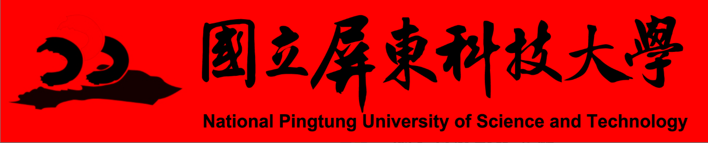
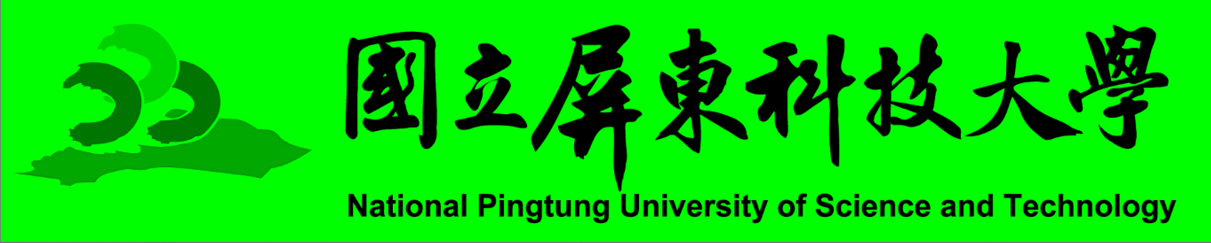
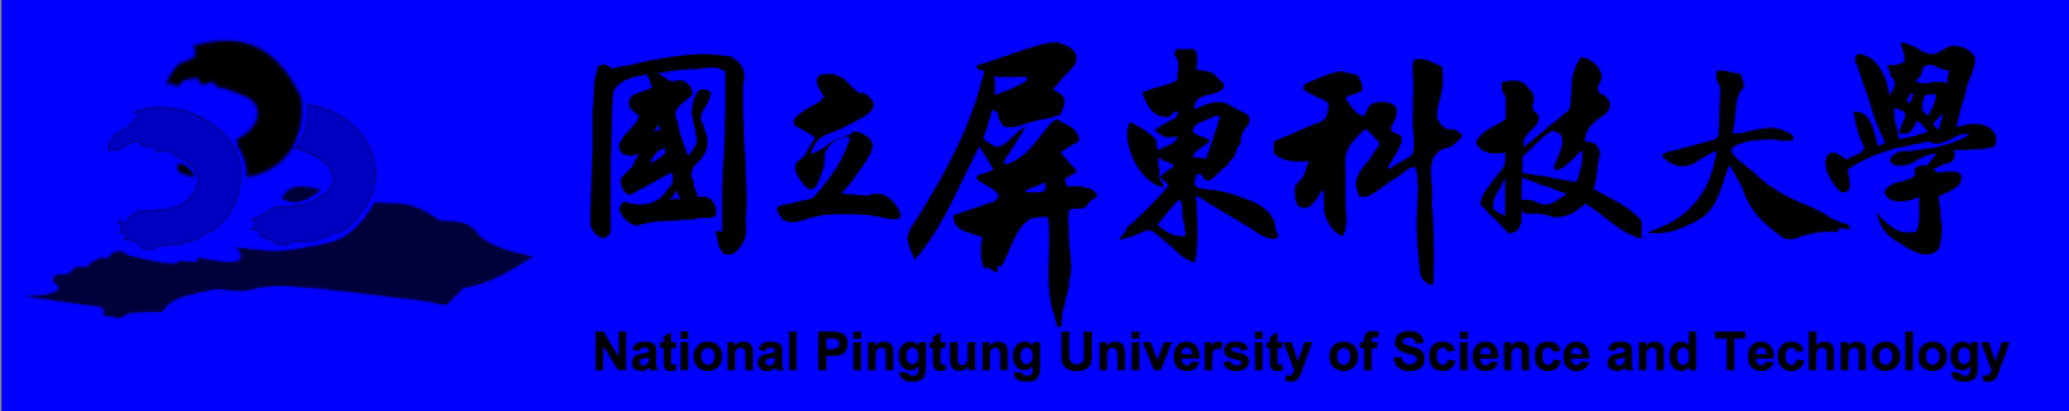
RGB三色通道
紅色通道
綠色通道
全彩原圖
藍色通道
import cv2 #原始圖像 Original = cv2.imread("images/01.jpg", cv2.IMREAD_COLOR) #R BGR = Original.copy() BGR[:, :, 0] = 0 #B BGR[:, :, 1] = 0 #G #G BGR = Original.copy() BGR[:, :, 0] = 0 #B BGR[:, :, 2] = 0 #R #B BGR = Original.copy() BGR[:, :, 1] = 0 #G BGR[:, :, 2] = 0 #R

Slide 5

灰階
全彩圖
灰階圖
import cv2 #原始圖像 Original = cv2.imread("images/01.jpg", cv2.IMREAD_COLOR) #灰階圖像 Grayscale = cv2.cvtColor(Original, cv2.COLOR_BGR2GRAY)

Slide 6




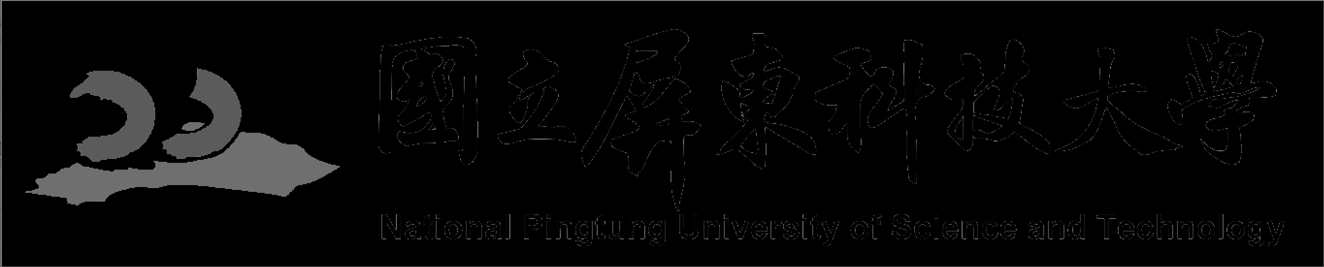
二值化
THRESH_BINARY:
超過閾值部分取maxval（最大值），否則取0
THRESH_BINARY_INV:
THRESH_BINARY的反轉
THRESH_TRUNC:
大於閾值部分設為閾值，否則不變
THRESH_TOZERO:
大於閾值部分不改變，否則設為0
THRESH_TOZERO_INV:
THRESH_TOZERO的反轉
import cv2 #原始圖像 Original = cv2.imread("images/01.jpg", cv2.IMREAD_COLOR) #灰階圖像 Grayscale = cv2.cvtColor(Original, cv2.COLOR_BGR2GRAY) #二值化 ret, thresh1 = cv2.threshold(Grayscale, 127, 255, cv2.THRESH_BINARY) #超過閾值部分取maxval（最大值），否則取0 ret, thresh2 = cv2.threshold(Grayscale, 127, 255, cv2.THRESH_BINARY_INV) #THRESH_BINARY的反轉 ret, thresh3 = cv2.threshold(Grayscale, 127, 255, cv2.THRESH_TRUNC) #大於閾值部分設為閾值，否則不變 ret, thresh4 = cv2.threshold(Grayscale, 127, 255, cv2.THRESH_TOZERO) #大於閾值部分不改變，否則設為0 ret, thresh5 = cv2.threshold(Grayscale, 127, 255, cv2.THRESH_TOZERO_INV) #THRESH_TOZERO的反轉

Slide 7




平滑
均值濾波:
速度較快，在圖像去噪的同時也破壞也會使圖像變得模糊。
方框濾波:
高斯濾波:
中值濾波:
非線性濾波，均值濾波對椒鹽噪聲的處理效果不好，但是中值濾波卻非常有效。
import cv2 #原始圖像 Original = cv2.imread("images/01.jpg", cv2.IMREAD_COLOR) #均值濾波 blur = cv2.blur(Original, (3, 3)) #方框濾波 box = cv2.boxFilter(Original, -1, (3, 3), normalize=True) # 高斯濾波 aussian = cv2.GaussianBlur(Original, (5, 5), 1) # 中值濾波 median = cv2.medianBlur(Original, 5)

Slide 8
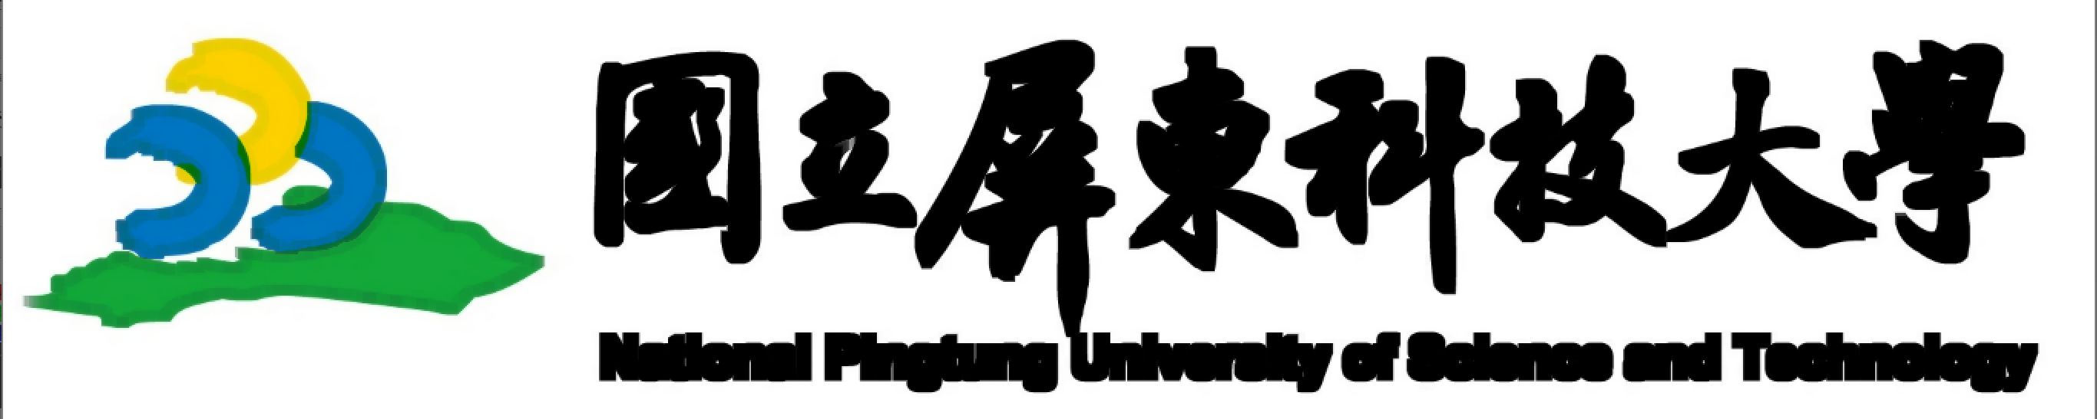



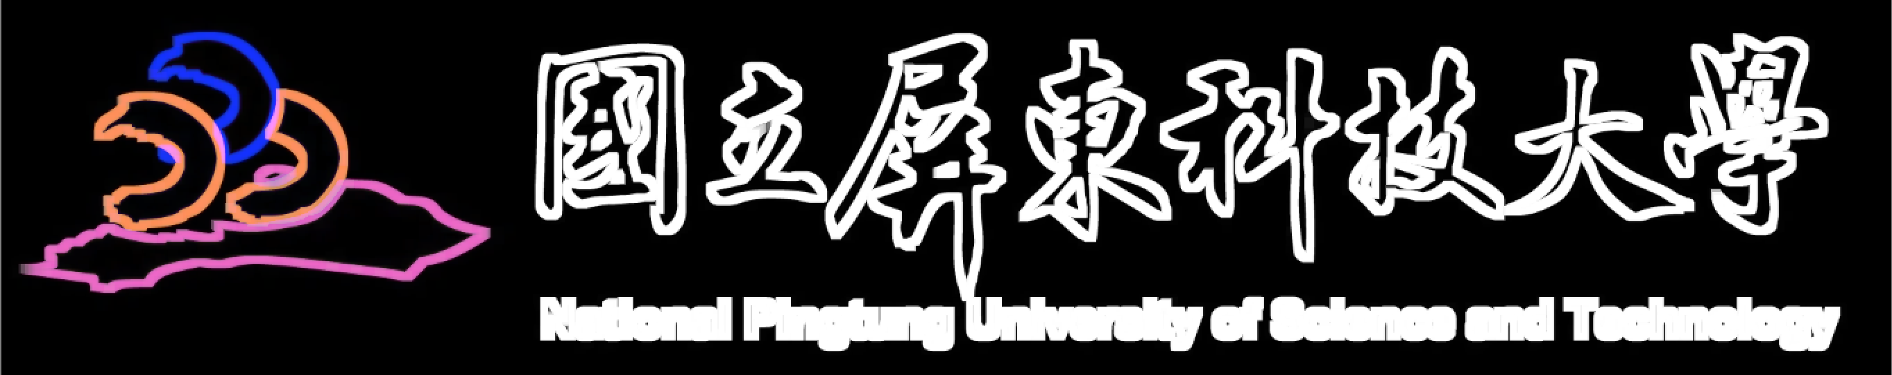
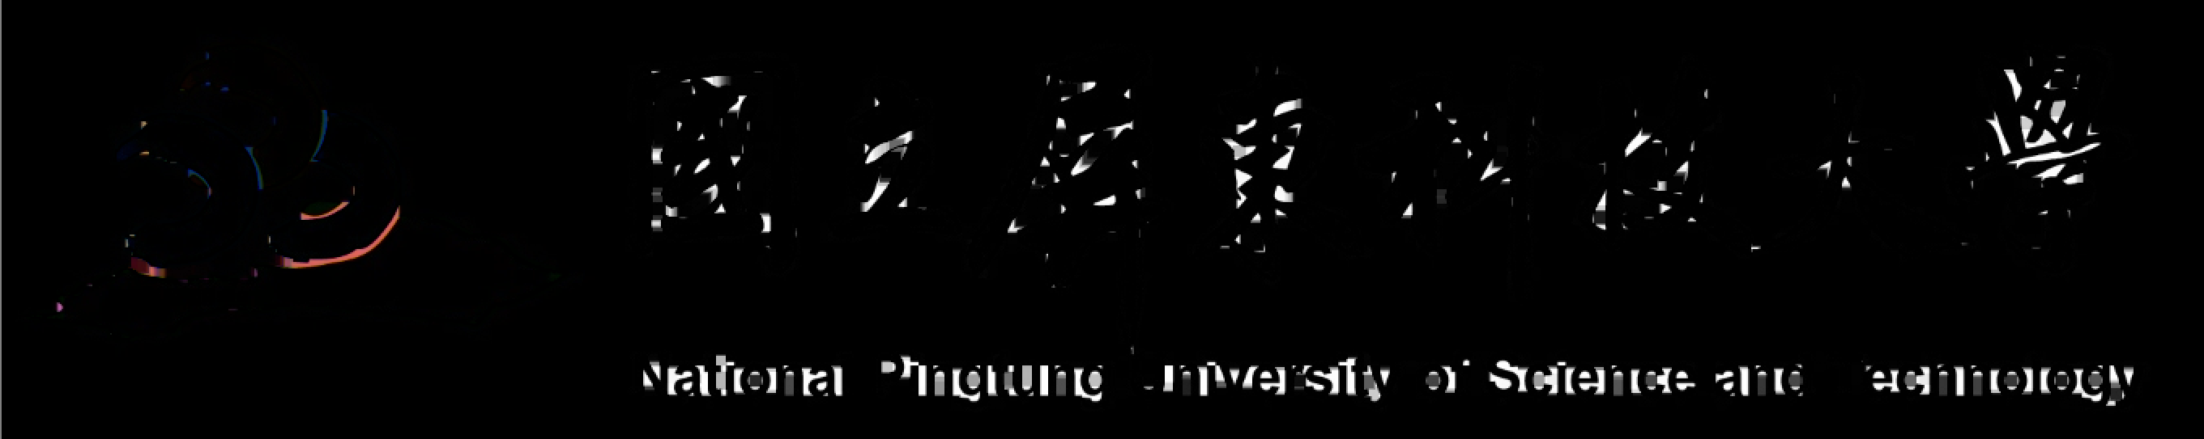
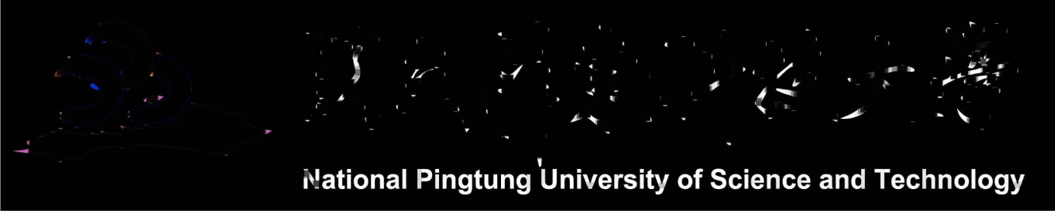
型態
腐蝕:
腐蝕和膨脹是對白色部分（高亮部分）而言的，不是黑色部分。腐蝕就是原圖中的高亮部分被腐蝕
膨脹:
腐蝕和膨脹是對白色部分（高亮部分）而言的，不是黑色部分。膨脹就是圖像中的高亮部分進行膨脹
開運算:
先腐蝕再膨脹
import cv2 import numpy as np #原始圖像 Original = cv2.imread("images/01.jpg", cv2.IMREAD_COLOR) #腐蝕 kernel = np.ones((3, 3), np.uint8) erosion = cv2.erode(Original, kernel, iterations=3) #膨脹 kernel = np.ones((3, 3), np.uint8) dilate = cv2.dilate(Original, kernel, iterations=3) #開運算 kernel = np.ones((5, 5), np.uint8) opening = cv2.morphologyEx(Original, cv2.MORPH_OPEN, kernel) #閉運算 kernel = np.ones((5, 5), np.uint8) closing = cv2.morphologyEx(Original, cv2.MORPH_CLOSE, kernel) #梯度運算 kernel = np.ones((7, 7), np.uint8) gradient = cv2.morphologyEx(Original, cv2.MORPH_GRADIENT, kernel) #頂帽 tophat = cv2.morphologyEx(Original, cv2.MORPH_TOPHAT, kernel) #黑帽 blackhat = cv2.morphologyEx(Original,cv2.MORPH_BLACKHAT, kernel)
閉運算:
先膨脹再腐蝕
梯度運算:
膨脹減去腐蝕 => 邊緣強化
頂帽運算:
原始減去開運算
黑帽運算:
閉運算減去原始

Slide 9

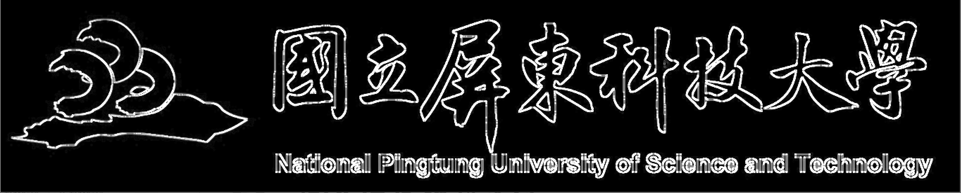
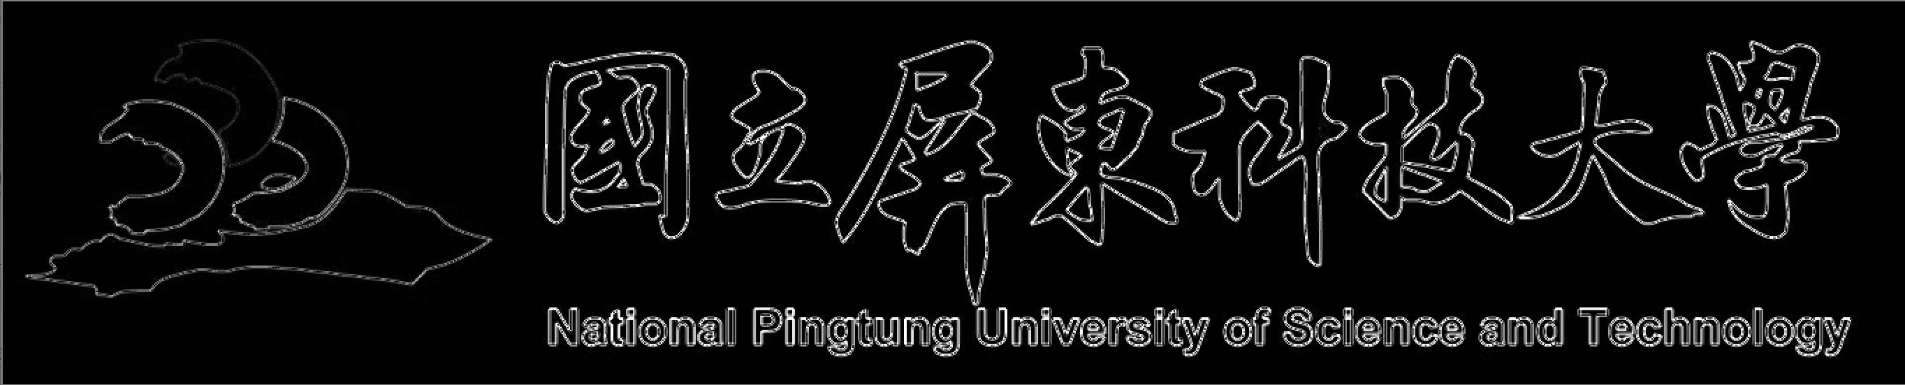
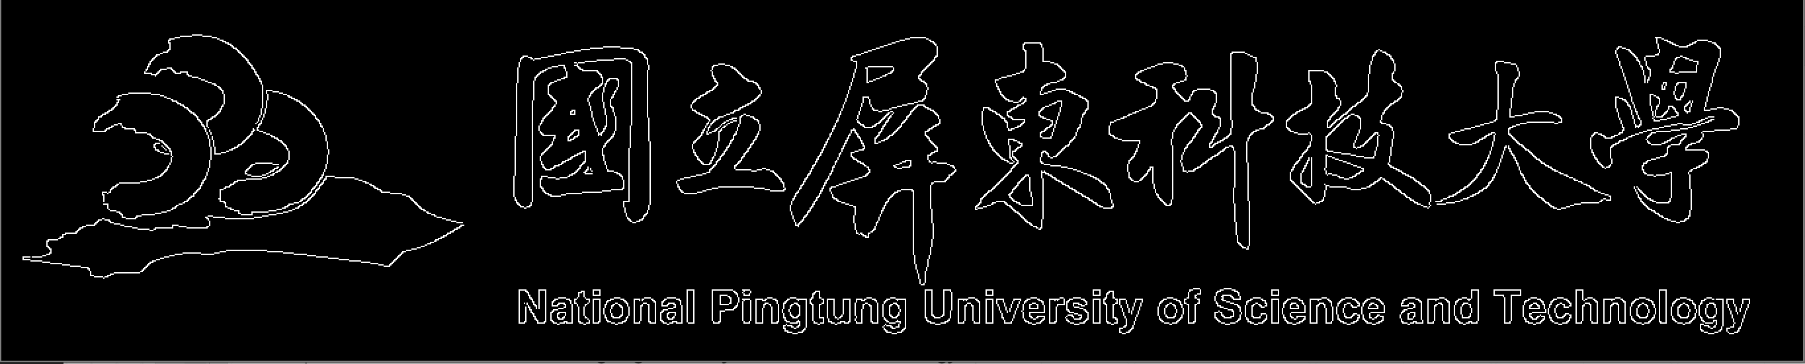
邊緣檢測
Sobel運算子:
Scharr運算子:
laplacian運算子:
import cv2 #原始圖像 Original = cv2.imread("images/01.jpg", cv2.IMREAD_COLOR) #灰階圖像 Grayscale = cv2.cvtColor(Original, cv2.COLOR_BGR2GRAY) #sobel sobelx = cv2.Sobel(Grayscale, cv2.CV_64F, 1, 0, ksize=3) sobelx = cv2.convertScaleAbs(sobelx) sobely = cv2.Sobel(Grayscale, cv2.CV_64F, 0, 1, ksize=3) sobely = cv2.convertScaleAbs(sobely) sobelxy = cv2.addWeighted(sobelx, 0.5, sobely, 0.5, 0) #Scharr Scharrx = cv2.Scharr(Grayscale, cv2.CV_64F, 1, 0) Scharrx = cv2.convertScaleAbs(Scharrx) Scharry = cv2.Scharr(Grayscale, cv2.CV_64F, 0, 1) Scharry = cv2.convertScaleAbs(Scharry) Scharrxy = cv2.addWeighted(Scharrx, 0.5, Scharry, 0.5, 0) #laplacian laplacian = cv2.Laplacian(Grayscale, cv2.CV_64F) laplacian = cv2.convertScaleAbs(laplacian) #Canny Canny = cv2.Canny(Grayscale, 100, 150)
Canny運算子:

Slide 10
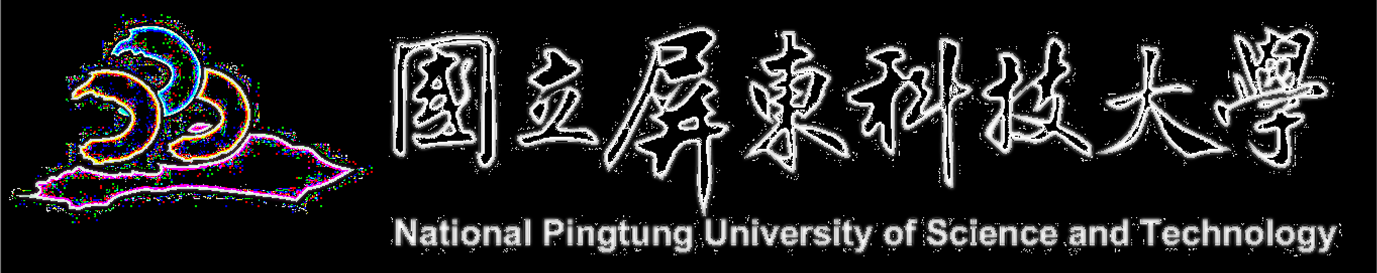
縮放
先縮小再放大之後減去原圖
import cv2 #原始圖像 Original = cv2.imread("images/01.jpg", cv2.IMREAD_COLOR) #拉普拉斯金字塔 down = cv2.pyrDown(Original) down_up = cv2.pyrUp(down) l_1 = Original - down_up

Slide 11
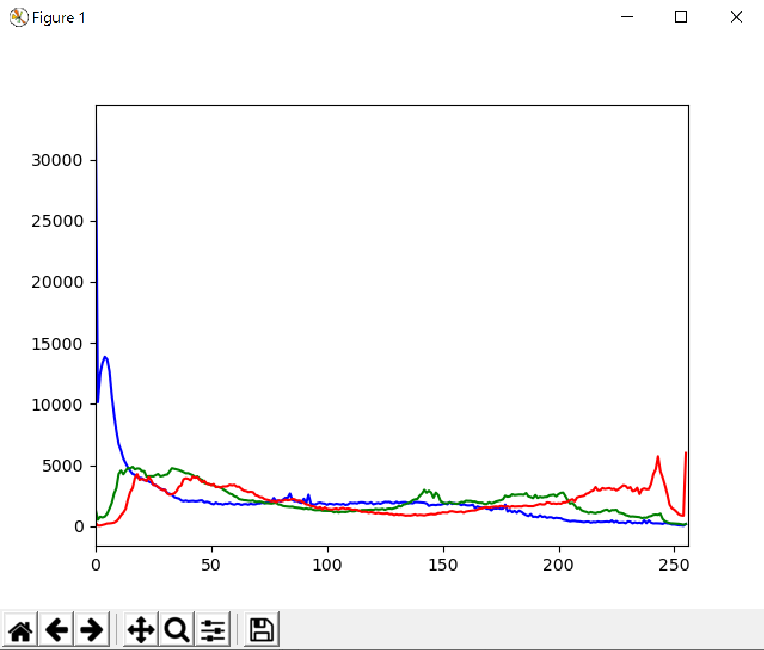

直方圖(彩色)
import cv2 import matplotlib.pyplot as plt #原始圖像 Original = cv2.imread("images/01.jpg", cv2.IMREAD_COLOR) #彩色 color = ('b', 'g', 'r') for i,col in enumerate(color): histr = cv2.calcHist([Original], [i], None, [256], [0, 256]) plt.plot(histr, color=col) plt.xlim([0, 256]) plt.show()

Slide 12
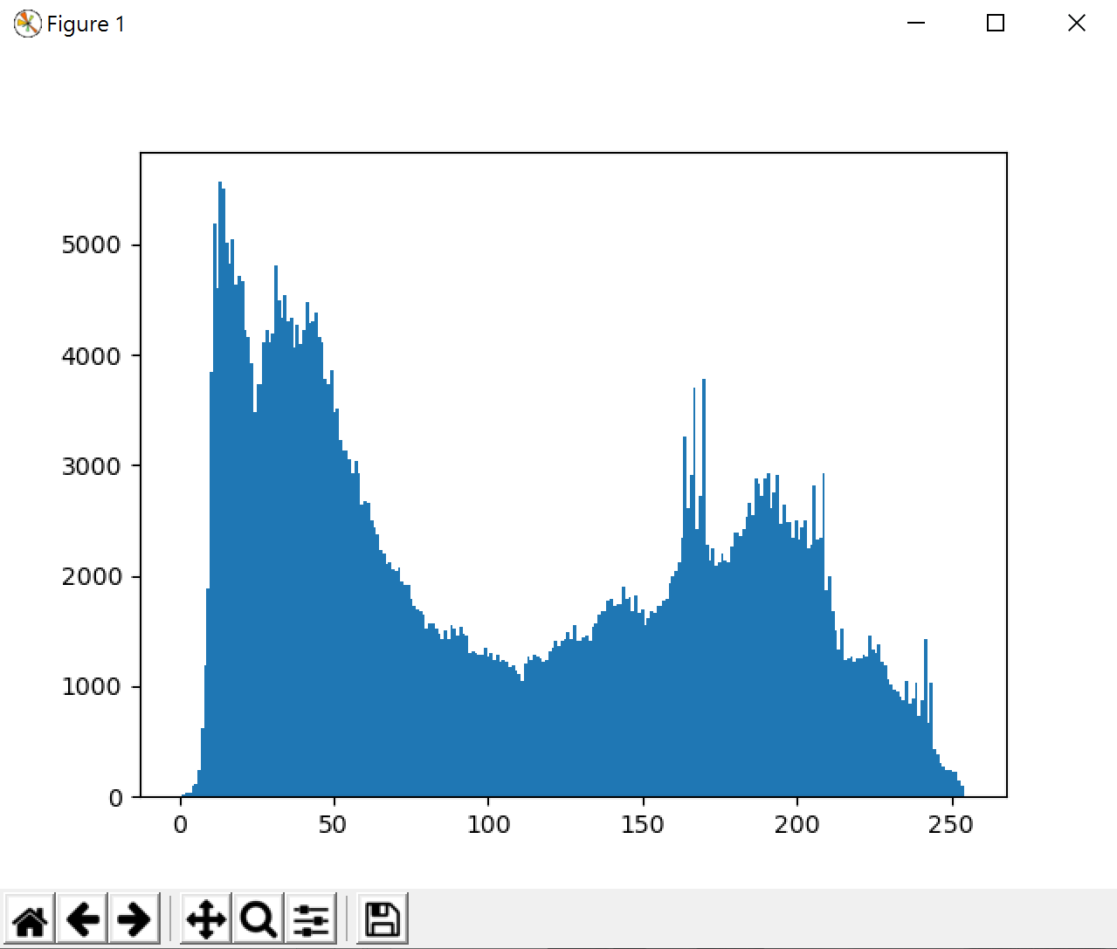
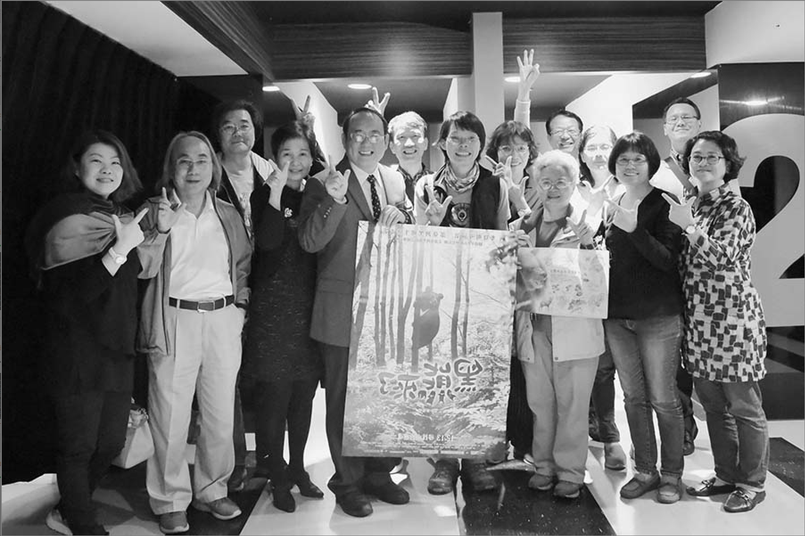
直方圖(灰階)
import cv2 import matplotlib.pyplot as plt #原始圖像 Original = cv2.imread("images/01.jpg", cv2.IMREAD_COLOR) #灰階 Grayscale = cv2.cvtColor(Original, cv2.COLOR_BGR2GRAY) hist = cv2.calcHist([Grayscale], [0], None, [256], [0, 256]) plt.hist(Grayscale.ravel(), 256)

Slide 13
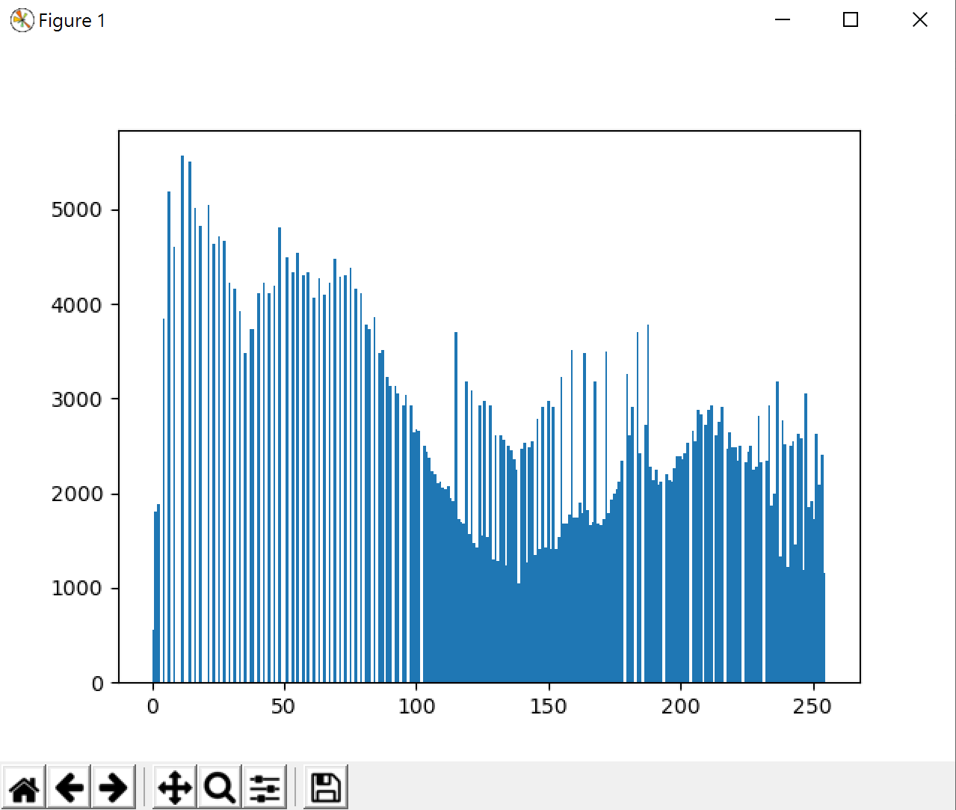
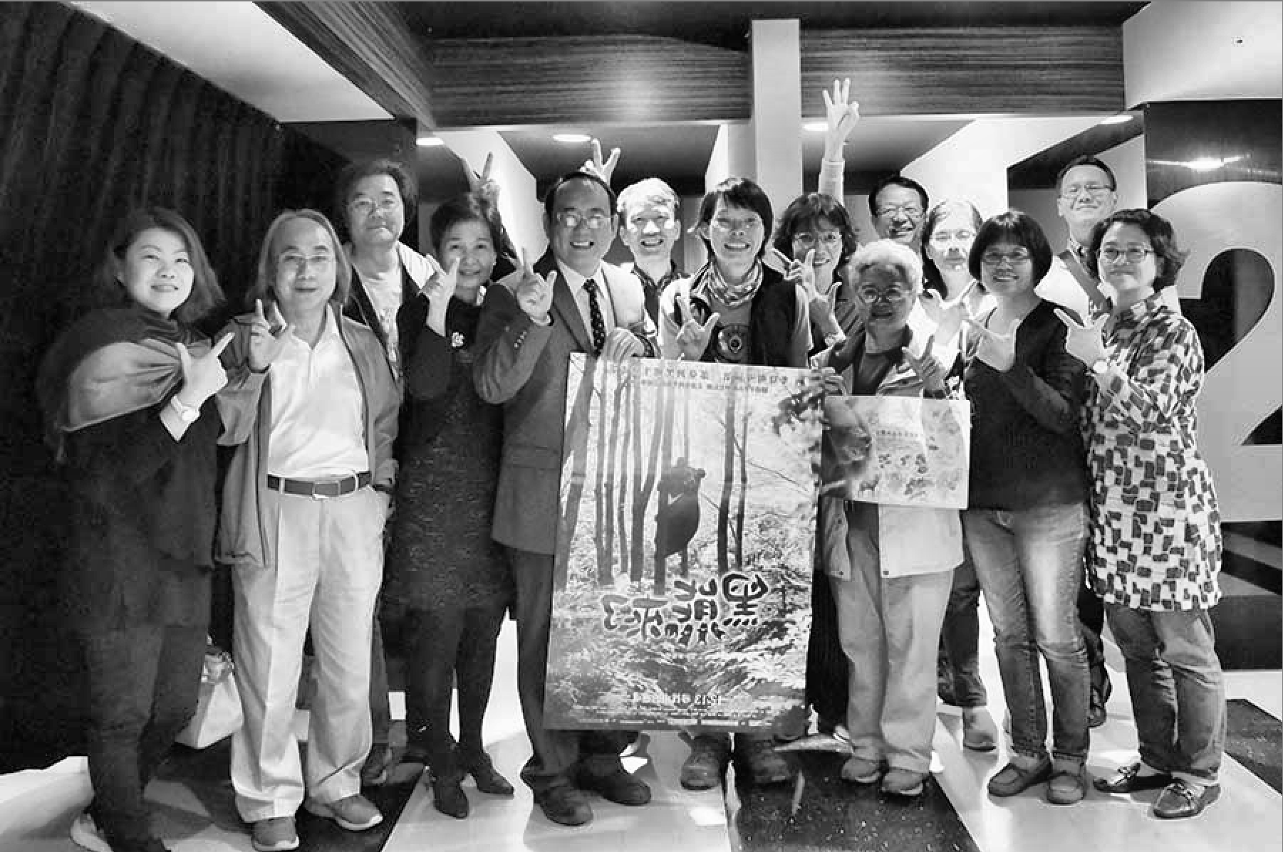
均值化
import cv2 import matplotlib.pyplot as plt #原始圖像 Original = cv2.imread("images/01.jpg", cv2.IMREAD_COLOR) #灰階 Grayscale = cv2.cvtColor(Original, cv2.COLOR_BGR2GRAY) #均衡化 equ = cv2.equalizeHist(Grayscale) plt.hist(equ.ravel(), 256) clahe = cv2.createCLAHE(clipLimit=2.0, tileGridSize=(8, 8)) res = clahe.apply(Grayscale)

Slide 14
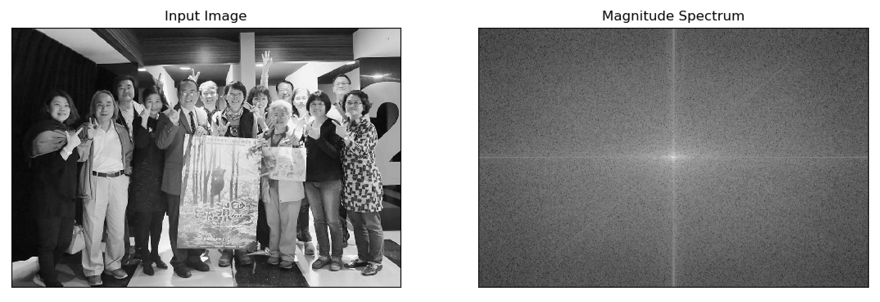
傅立葉轉換:
import cv2 import numpy as np #原始圖像 Original = cv2.imread("images/01.jpg", cv2.IMREAD_COLOR) #灰階 Grayscale = cv2.cvtColor(Original, cv2.COLOR_BGR2GRAY) #傅立葉轉換 img_float32 = np.float32(Grayscale) dft = cv2.dft(img_float32, flags=cv2.DFT_COMPLEX_OUTPUT) dft_shift = np.fft.fftshift(dft) magnitude_spectrum = 20*np.log(cv2.magnitude(dft_shift[:, :, 0], dft_shift[:, :, 1]))
高頻：變化劇烈的區域，如邊界
低頻：變化緩慢的區域，如海洋

Slide 15
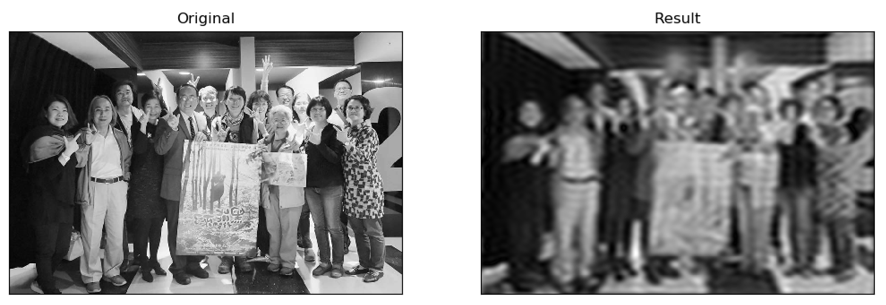
低通濾波：只保留低頻區域，使圖像模糊
import cv2 import numpy as np #原始圖像 Original = cv2.imread("images/01.jpg", cv2.IMREAD_COLOR) #灰階 Grayscale = cv2.cvtColor(Original, cv2.COLOR_BGR2GRAY) img_float32 = np.float32(Grayscale) dft = cv2.dft(img_float32, flags=cv2.DFT_COMPLEX_OUTPUT) dft_shift = np.fft.fftshift(dft) rows, cols = Grayscale.shape crow, ccol = int(rows/2) , int(cols/2) # 中心位置 mask = np.zeros((rows, cols, 2), np.uint8) mask[crow-30:crow+30, ccol-30:ccol+30] = 1 # IDFT fshift = dft_shift*mask f_ishift = np.fft.ifftshift(fshift) img_back = cv2.idft(f_ishift) img_back = cv2.magnitude(img_back[:, :, 0],img_back[:, :, 1])

Slide 16
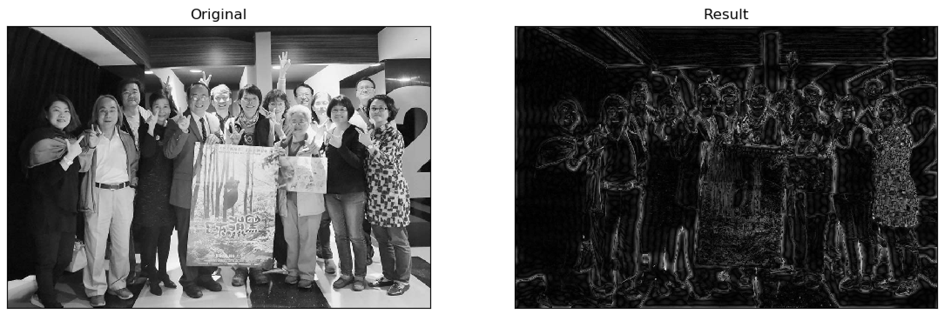
高通濾波：只保留高頻，使圖像細節增強
import cv2 import numpy as np #原始圖像 Original = cv2.imread("images/01.jpg", cv2.IMREAD_COLOR) #灰階 Grayscale = cv2.cvtColor(Original, cv2.COLOR_BGR2GRAY) img_float32 = np.float32(Grayscale) dft = cv2.dft(img_float32, flags=cv2.DFT_COMPLEX_OUTPUT) dft_shift = np.fft.fftshift(dft) rows, cols = Grayscale.shape crow, ccol = int(rows/2) , int(cols/2) # 中心位置 mask = np.ones((rows, cols, 2), np.uint8) mask[crow-30:crow+30, ccol-30:ccol+30] = 0 # IDFT fshift = dft_shift*mask f_ishift = np.fft.ifftshift(fshift) img_back = cv2.idft(f_ishift) img_back = cv2.magnitude(img_back[:, :, 0], img_back[:, :, 1])

